Slide 1
Math Coffee
6th Grade

Slide 2
Purpose for Today
Introduce the lesson structure provided through the Big Ideas resource.
Illustrate the instructional supports offered by the Big Ideas Resource.

Slide 3
Big ideas instructional support

Slide 4
Instructional Design of Big Ideas
Explore
Instruct
Practice/Deepen Understanding of Concepts/Skills

Slide 5
Explore
Intended to introduce the lesson to the students.
Allows students to construct new knowledge from prior knowledge.
Helps engage students into the learning process.

Slide 8
Instruct
Opportunity for the teacher to provide new information opportunities to students
Teacher provides guided practice and feedback on the lesson target.

Slide 11
Guided Practice

Slide 12
Deepen Knowledge
Opportunity for students to practice new learning.
Chance for students to extend their knowledge.
Allows students to maintain prior skills and concepts.

Slide 17
Big ideas Parent & Student support

Slide 18
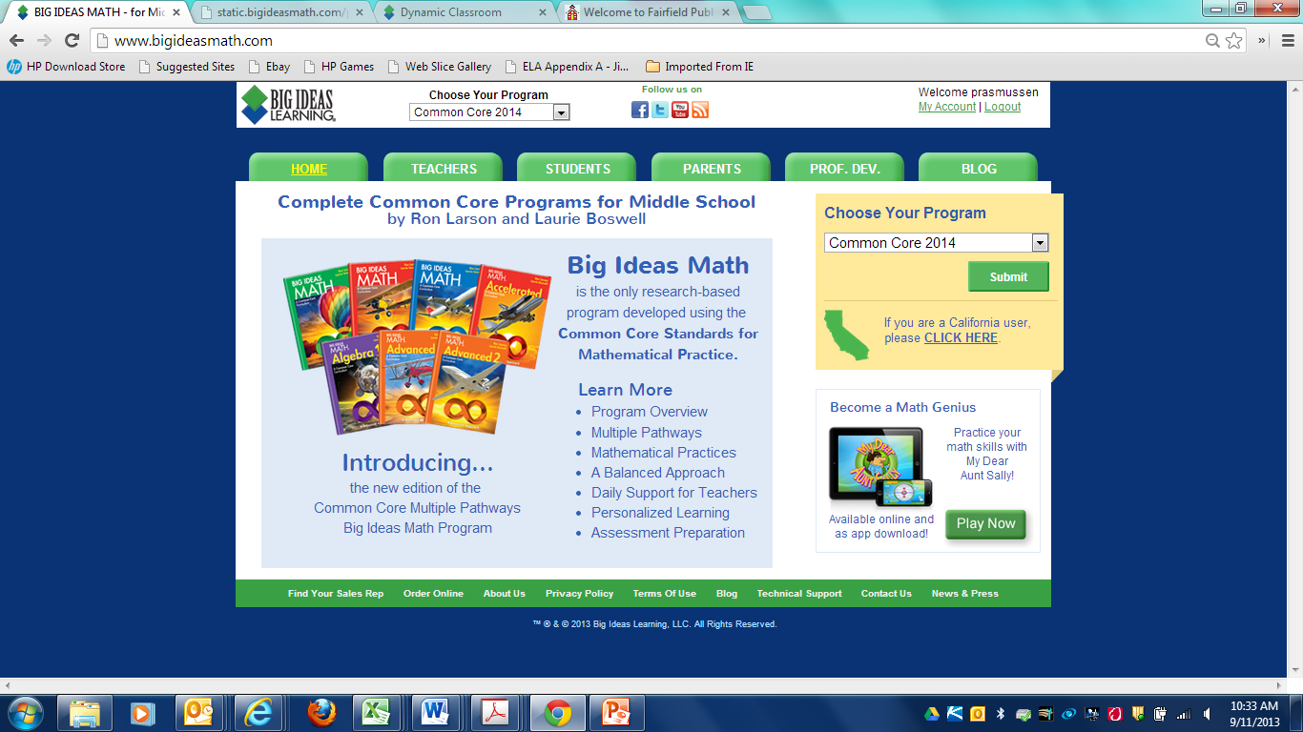

Slide 19
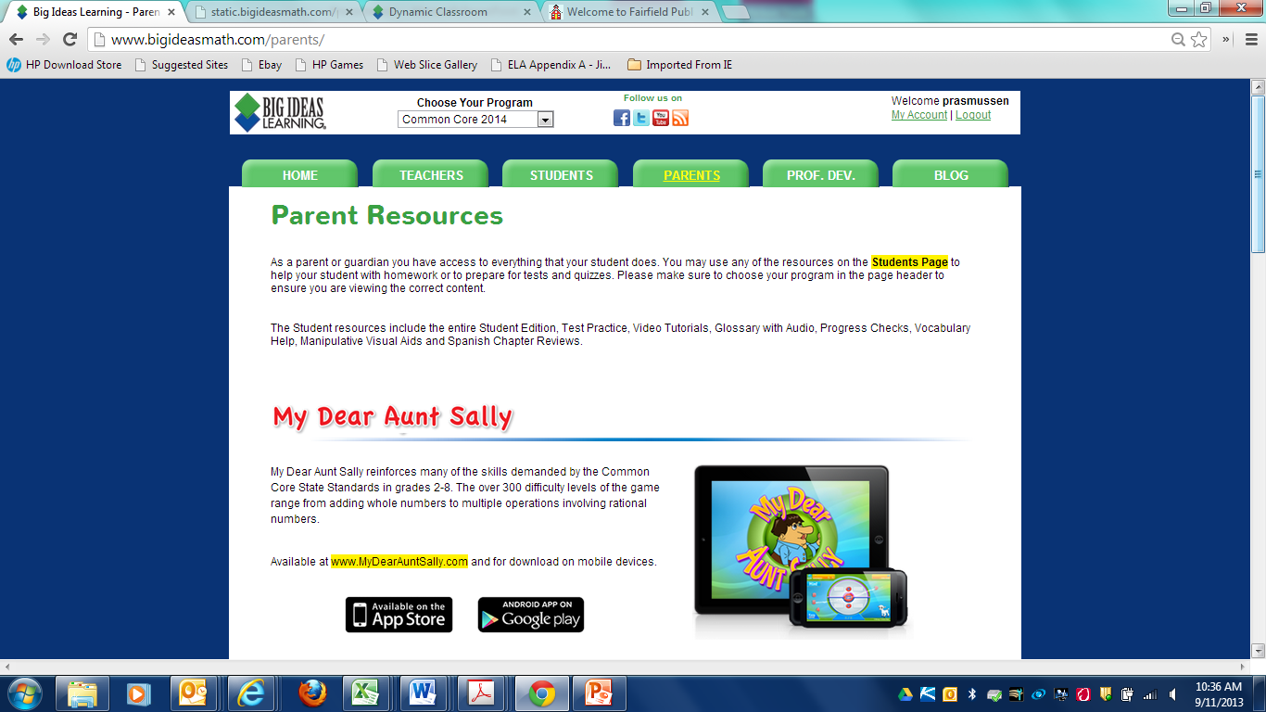

Slide 22
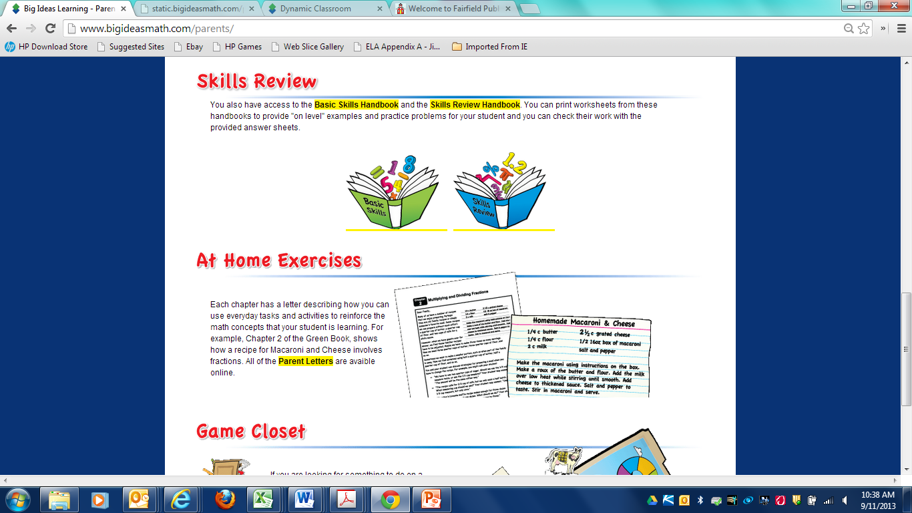

Slide 23
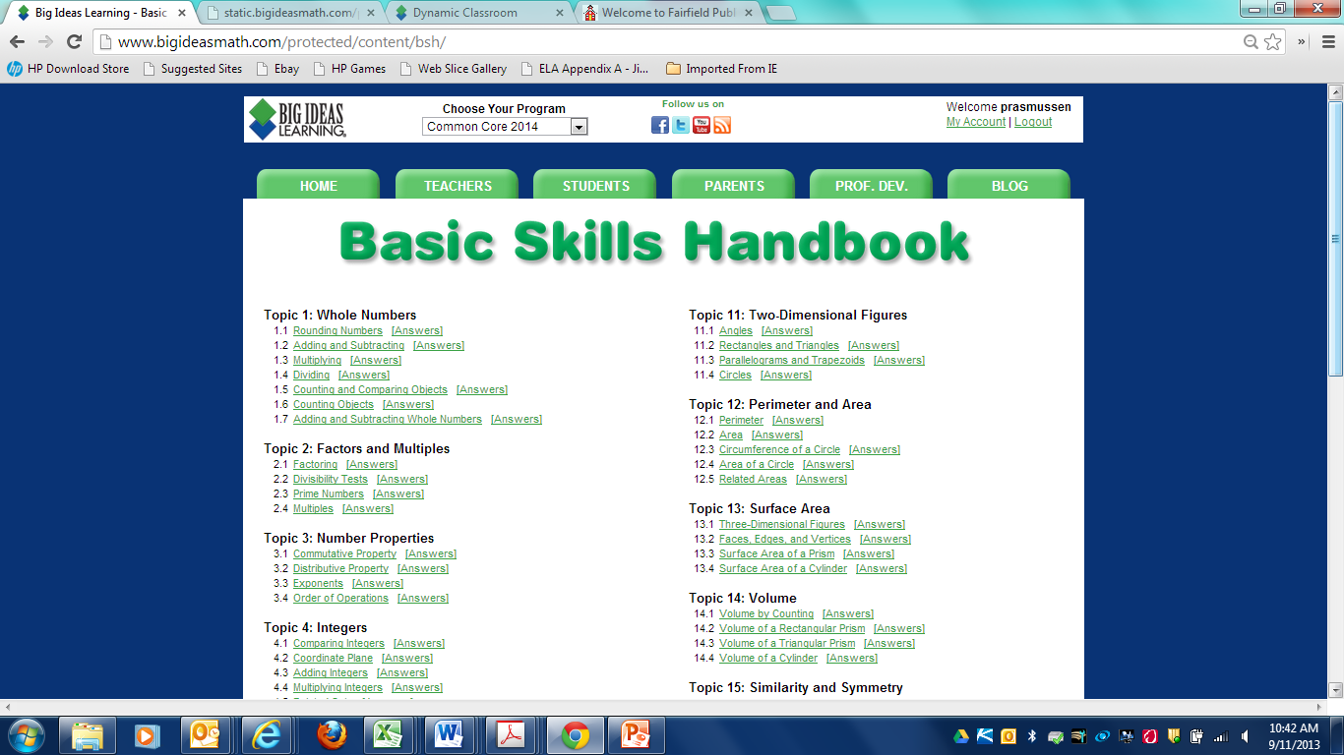

Slide 28
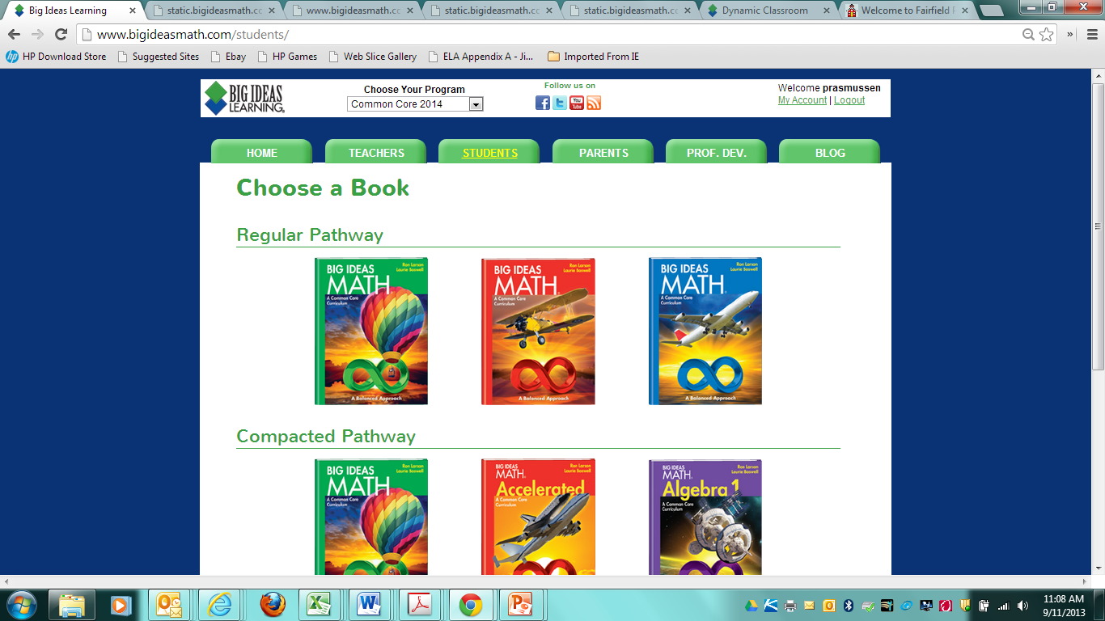

Slide 29
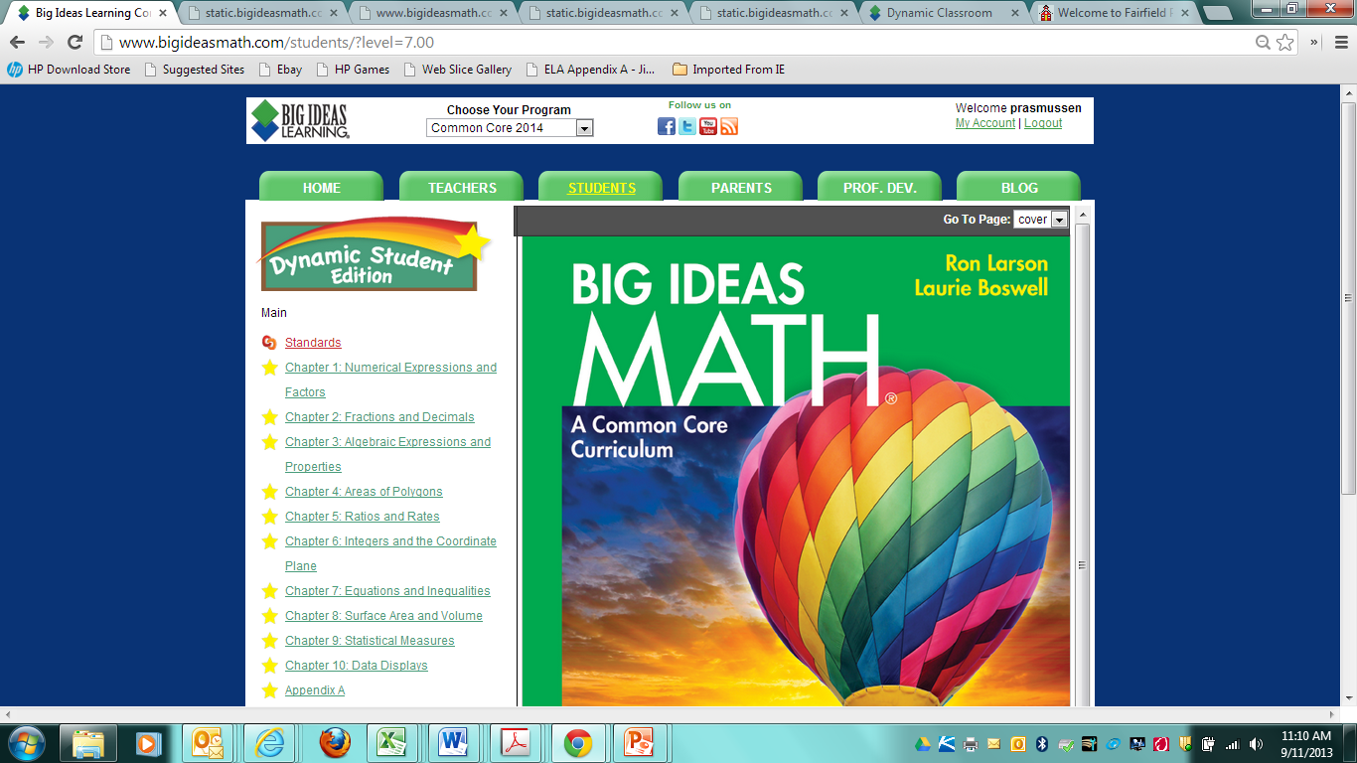

Slide 30
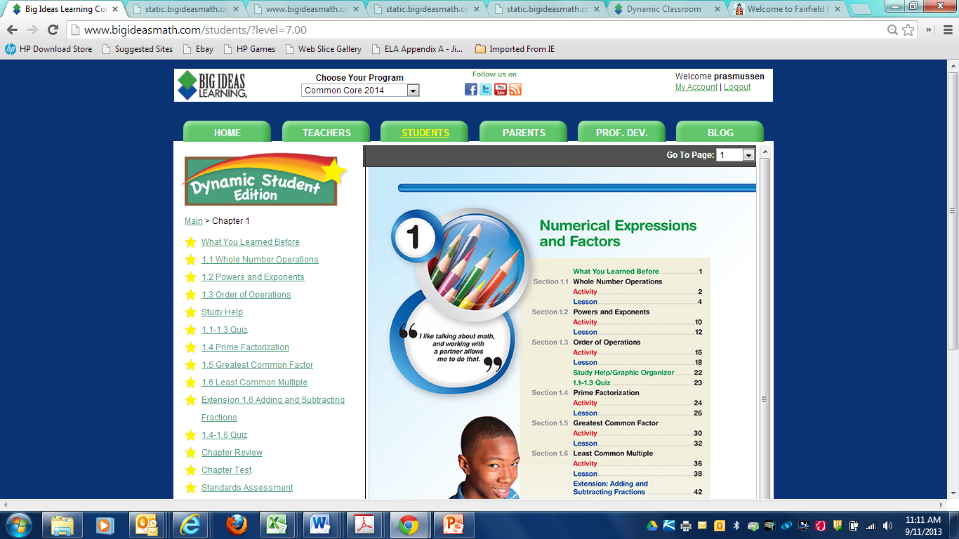

Slide 31
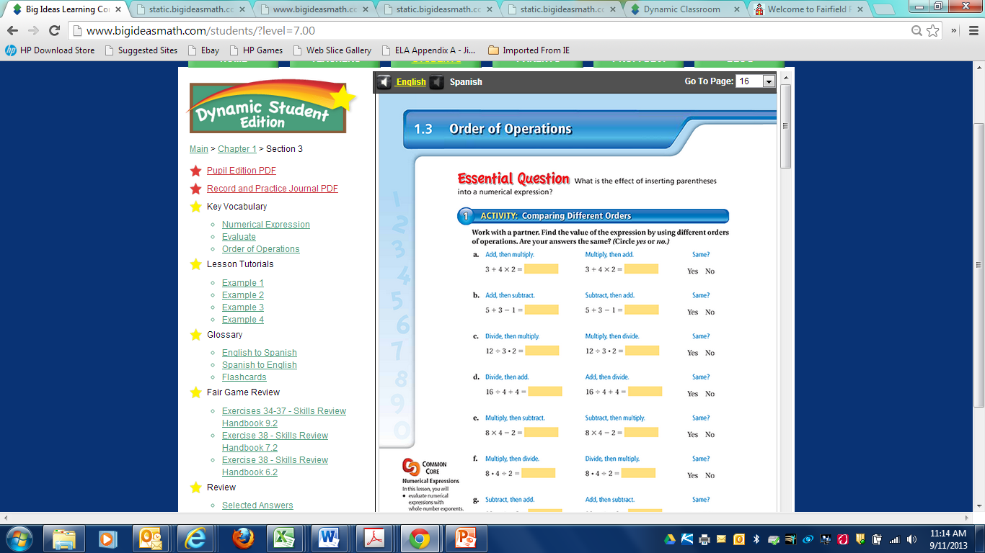

Slide 32
http://www.bigideasmath.com/protected/content/dcs_cc2/tutorials/mp4/va/grade%206/chapter%201/section%202/va_ltut_6_01_02_1/va_ltut_6_01_02_1.html

