Slide 1
Business Department
Curriculum Review 2013

Slide 2
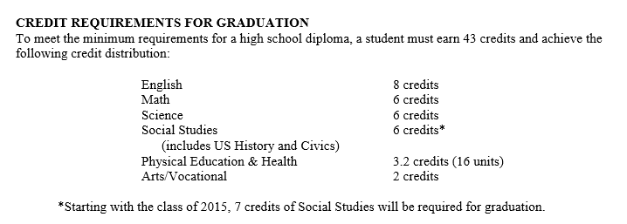
Elective Offerings

Slide 3
COURSE OFFERINGS | Grade 9 | Grade 10 | Grade 11 | Grade 12
Introduction to Business | X | X
Marketing |  | X | X | X
Accounting |  | X | X | X
Business Law |  | X | X | X
Business Management |  | X | X | X
The Business of Sports & Entertainment |  | X | X | X
AP Economics |  | X | X | X
Advanced Advertising & Design |  |  | X | X
Entrepreneurship |  |  | X | X
Internship & Career |  |  | X | X
Computer Information Systems | X | X | X | X
Computer Game Design & Programming | X | X | X | X
Robotic Programming | X | X | X | X
Web Design | X | X | X | X
AP Computer Science |  |  | X | X

Slide 4
Characteristics of an Elective Program
The Business program, as an elective, is part of very competitive free market.
Our courses attract a wide range of students with different backgrounds and interests.
As a result, we have designed courses that meet the needs of a variety of students.

Slide 5
Growth in Enrollment
 | 2009 | 2010 | 2011 | 2012 | 2013
Business Management | 39 | 43 | 42 | 71 | 88
 | 2009 | 2010 | 2011 | 2012 | 2013
Marketing | 29 | 23 | 41 | 98 | 115
 | 2009 | 2010 | 2011 | 2012 | 2013
Introduction to Business | 31 | 45 | 53 | 94 | 138

Slide 6
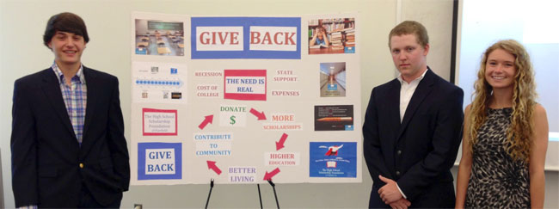
Why this increase?
Increased consistency between courses, leading to career paths.
Focus on real-world skills and concepts while allowing students to apply the curriculum to their own ideas using hands-on projects and simulations.
Create a competitive atmosphere and involve the community!
Notes:
Create a solid foundation and smooth transitions while avoiding unnecessary overlap

Slide 7
Strengths of our Program

Slide 8
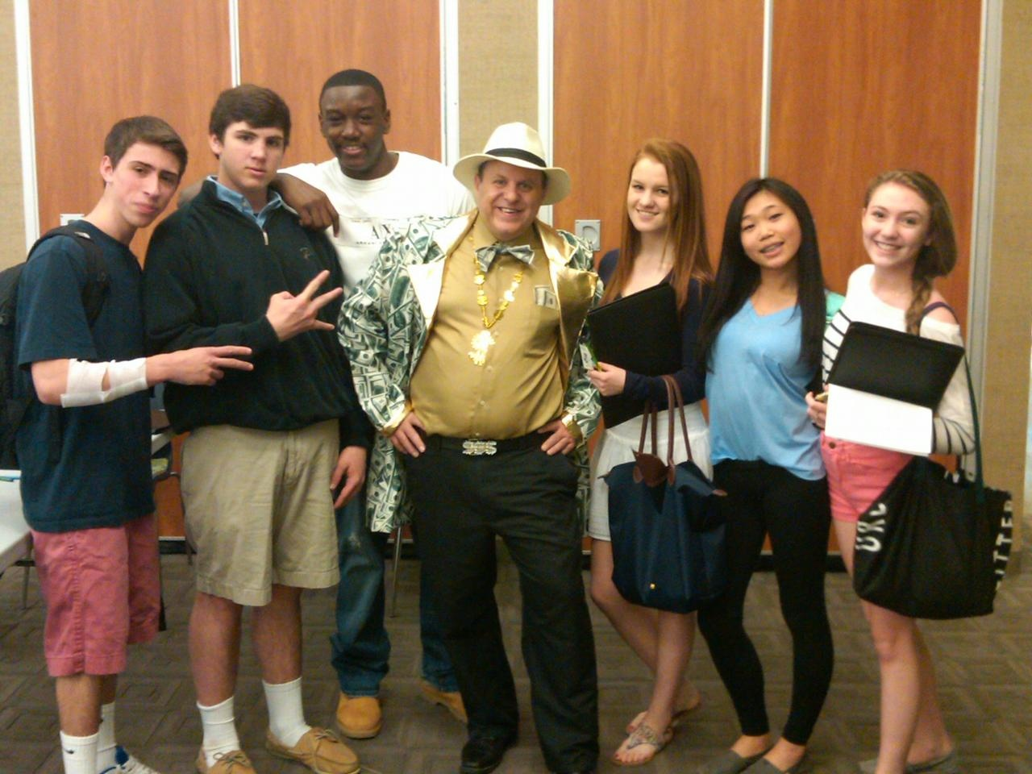
Our Business Students
Consistently demonstrate 21st century skill sets such as creativity, innovation, problem-solving, collaboration and perseverance.

Slide 9
Our Business Students
Are provided with a platform to find their niche.

Slide 10
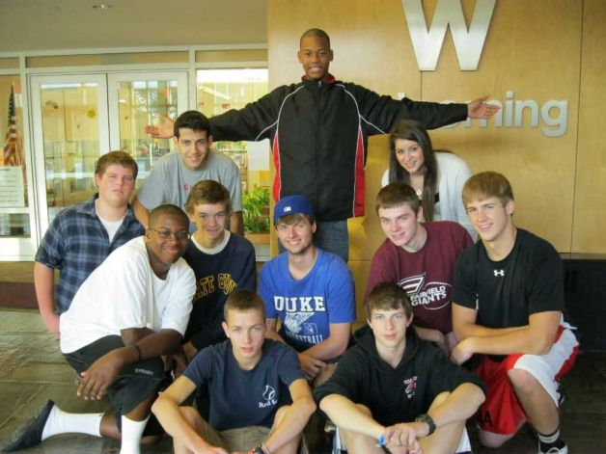
Our Business Students
Are shown the real-world application of what they are learning in their core classes.

Slide 11
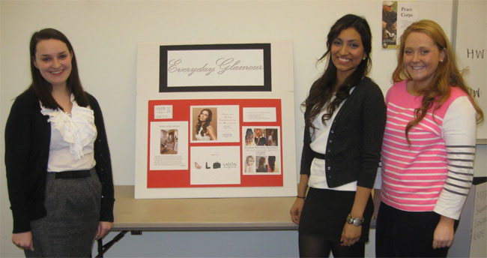
Our Business Students
Are constantly challenged to become more effective communicators.
Notes:
In the world we live in, there is more competition for people’s attention and less time to grab it

Slide 12
Testimonials
Ms. Nina Carter
FLHS Graduate - Class of 2012
Psychology/Marketing Major – Marymount Manhattan College
Intern: Divalysscious Moms Event Planning
Mr. Rod Morton
Parent of FWHS Student
CEO: Rod Morton Creative and college professor
Volunteer: Curriculum Focus Groups & FLHS Advertising Class
Mr. David Downie
Associate Professor of Politics- Yale University
Parent of Four-Year FLHS Business Student
Son has continued to serve on the Board of Trustees for Fairfield Scholarship Foundation after completing the Fairfield Advertising Competition

Slide 13
Revisions to Curriculum

Slide 14
Revisions to Curriculum
Revisions were made in
Wording and Formatting
Unit order, length and/or sequence
All curriculum aligns with State and National Business Standards and 21st Century Skills

Slide 15
Process used
Time | Actions
2012-13 school year | Fairfield teachers reviewed current curriculum; need for additional courses assessed.
Spring –summer 2013 | Fairfield teachers revised curriculum documents
Fall 2013 | All Business teachers in Fairfield reviewed and provided input on curriculum documents.
Fall 2013 | Parent focus groups scheduled; draft documents posted on district website.
November 21, 2013 | District Curriculum Coordinating Council (CCC) reviewed and approved documents
December 10, 2013 | Curriculum presented to Board of Education

Slide 16
Business Presentations & Public Speaking Skills

Slide 17
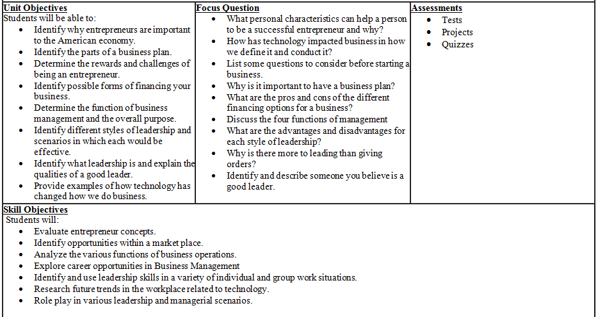

Slide 18
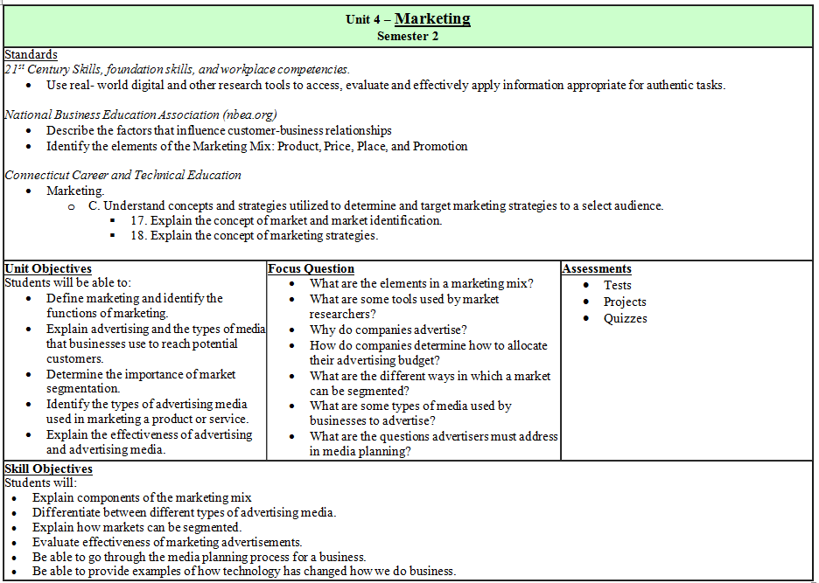

Slide 19
Changes: Marketing
Notes:
Add section to curriculum about presentation skills
Embedded selling skills throughout the course
Added a section on Promotion to separate it from Advertising (they are not the same)
-Added a subsection on Public Relations
-Will allow for more time spent on modern advertising strategies – using social media, etc
Lengthened last unit to allow for application to developing a new product

Slide 20
Changes: Accounting

Slide 21
New Classes
Financial Literacy
Grades 10, 11, 12
Introduction to Investing & Finance
Grades 11, 12

Slide 22
Why Is Financial Literacy Important?
7 in 10 college seniors graduated with debt last year
Average debt per borrower: $29,400
Young adults between 20 and 24 represent the fastest growing segment of bankruptcy filings
The rate of college graduates filing for bankruptcy went up 20% in 2011
Source:
Jump$tart: Making the Case for Financial Literacy
The Project on Student Debt

Slide 23
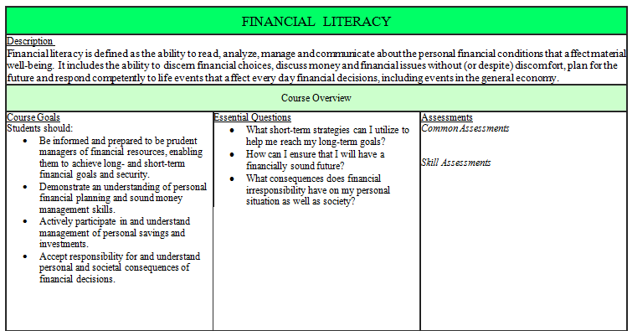

Slide 25
Implementation Cost
Summer work to develop common assessments and implementation guides
120 hours @ 38.76 per hour = $4651.20
Purchase textbooks for new Financial Literacy course
40 students (estimated) @ $37.50 per student = $1500.00

Slide 26
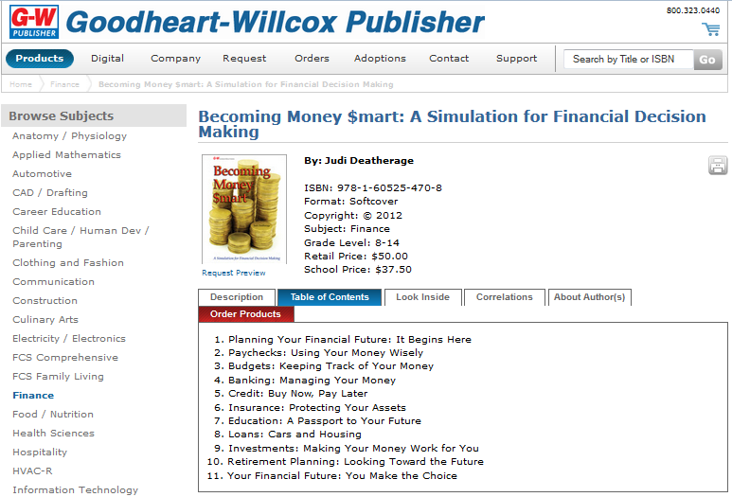

Slide 27
Evaluation of New Curriculum
Evaluation of common assessments that measure student mastery of key concepts as well as consistent implementation of the curriculum.
Observations by school-based administrators focused on content, delivery and assessment of curriculum.
Student enrollment in these elective courses.
Feedback from professionals in the field as well as graduates of our high schools.

Slide 28
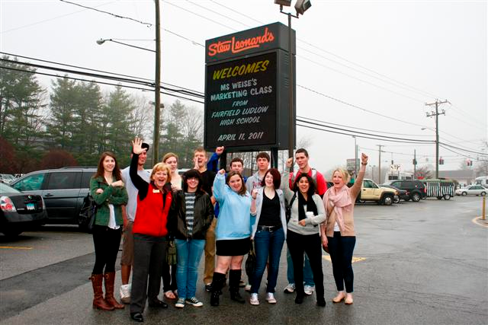
Thank You!

